Slide 1

#48 Rotate Image
Akhtamov Azimjon 2024299010
2025-01-16

Slide 2
Problem Definition (1)
Source: Leetcode
Title: Merge Intervals
Difficulty: medium
Type: Matrix

Slide 3
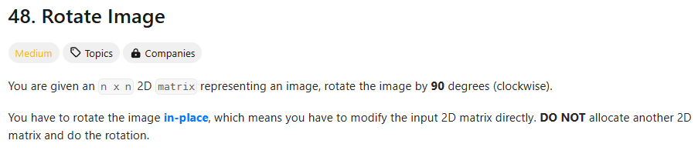
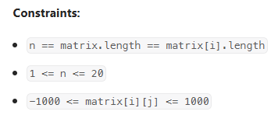
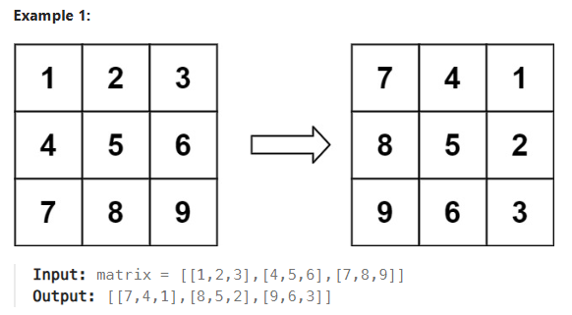
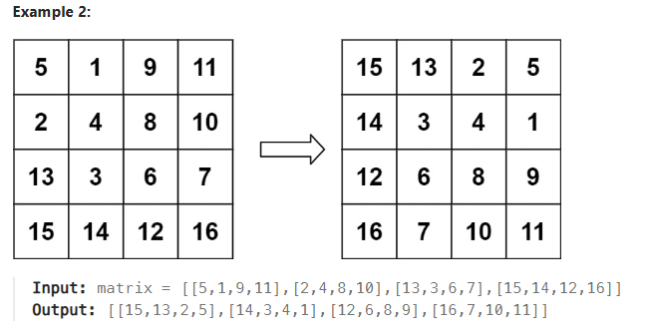
Problem Definition (1)

Slide 4
Solution (1): Step1
a( i,j ) = a*( j,i )
i = ROW
# Transposation
1
2
3
1
4
7
4
5
6
j = Column
2
5
8
7
8
9
3
6
9

Slide 5
Solution (2): Step2
# Horizontal Reflection
1
2
3
# Rotated Image
4
5
6
1
4
7
7
4
1
7
8
9
2
5
8
8
5
2
3
6
9
9
6
3
I solved this problem based on Step #1 and #2

Slide 6
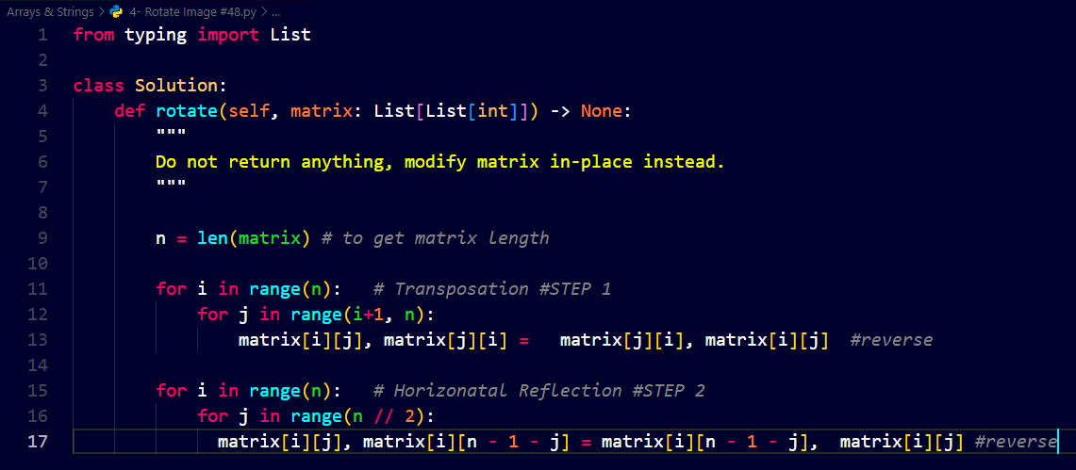
Solution (3)

Slide 7
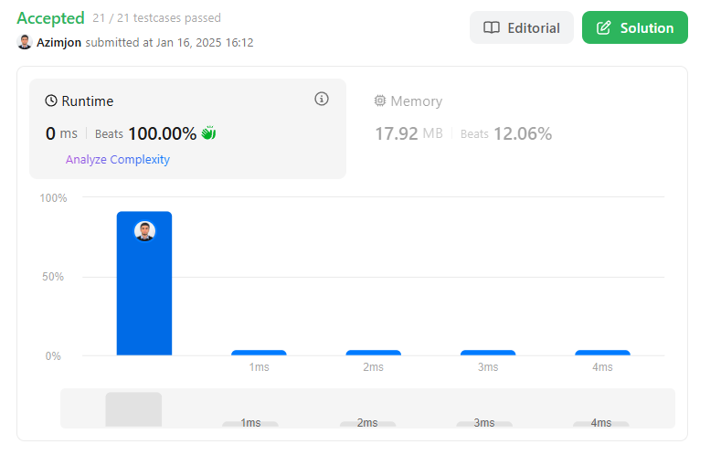
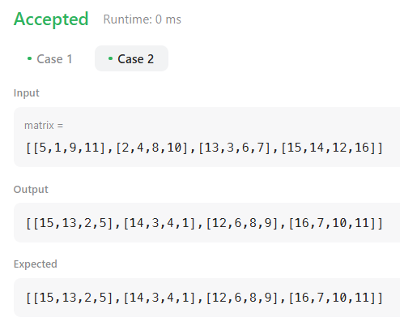
Solution (3)

Slide 8
What I have learned
MATRIX:
I split problem into 2 steps:
Step1 - Transposation Step2 - Horizontally Reflection I got technique kinda solving problem by seperating into steps
Understood logic of changing matrix indexes

Slide 9
Questions and Answers

Slide 10
Greetings

